Slide 1



Final Project Presentation
May 2025
PREDICTING COLLEGE ADMISSION BASED ON HIGH SCHOOL DATA
Team: ERALASH
Course: Big Data Analysis (IBT4105-001)
Professor: Dr. Vijay Kakani

Slide 2










TEAM MEMBERS
“The strength of the team is each individual member. The strength of each member is the team.”
- Phil Jackson
Novikova Anna
Ochgerel Buyandelger
12230292
12230296
ERALASH
Grishaeva Arina
Purev Nomin Erdene
12230285
12230265

Slide 3




EXECUTIVE SUMMARY
This project develops a predictive model using students' academic and extracurricular data to estimate college admission or scholarship chances.
KEY COMPONENTS:
1
Kaggle dataset on admissions + original student survey
2
Logistic Regression & Decision Trees for prediction
3
GPT used for qualitative survey analysis and report drafting

Slide 4

PURPOSE
Help students and counselors make informed, strategic application decisions.
LETS GET STARTED

Slide 5





INTRODUCTION
Objective
Problem Statement
Use Case
Build a predictive system using student data to identify key factors behind admissions decisions and deliver personalized insights.
Admissions can feel unclear and stressful, with inconsistent criteria across institutions. Both students and schools lack scalable tools for decision-making.
Students: Understand strengths, improve weak areas, choose schools wisely
Counselors: Use predictions to advise students more effectively

Slide 6

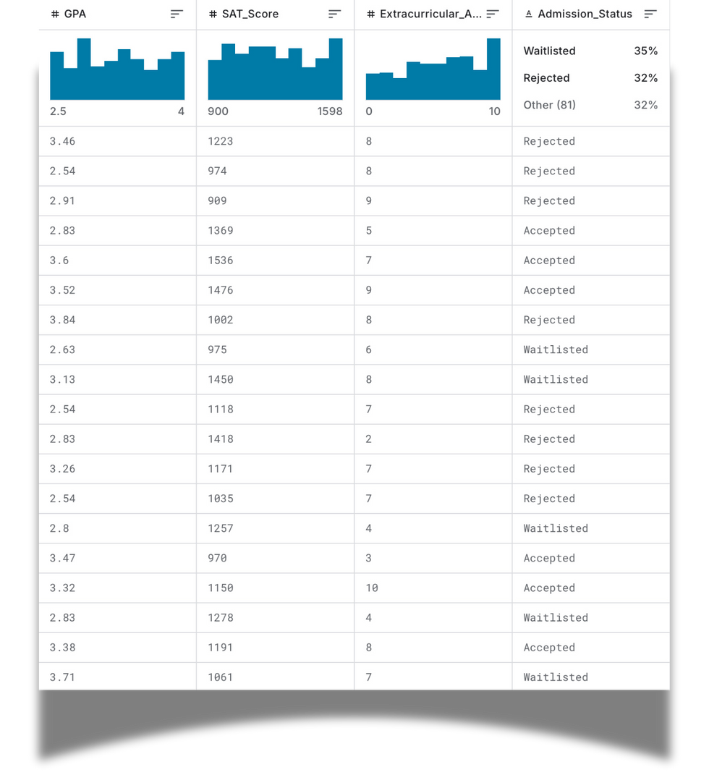

DATA SOURCES – DATASET
KAGGLE dataset
https://www.kaggle.com/datasets/amanace/student-admission-dataset
Kaggle "Student Admission Dataset"
Features: GPA, SAT scores, essays, extracurriculars, recommendations
Used for model training and prediction

Slide 7
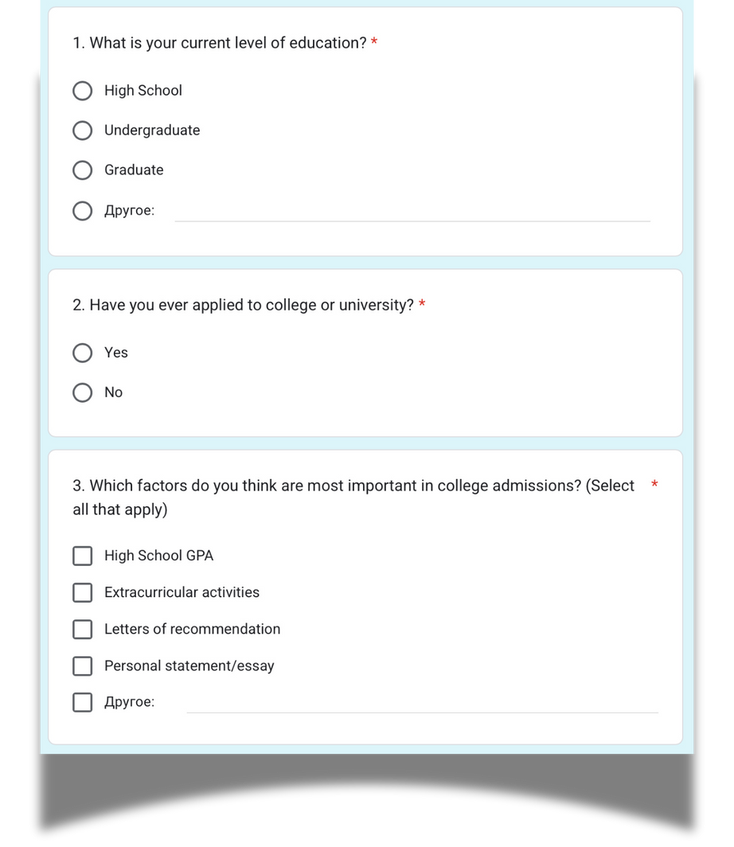


SURVEY
https://docs.google.com/forms/d/e/1FAIpQLSdYokubvdc2GPzOLwjh-Kc3niscLyYrsS5dzn6Ftysn7aojWA/viewform?usp=header
Collected from 30+ students
Mixed format (multiple choice, Likert, open-ended)
Measured perceptions on admissions factors and AI tools

Slide 8
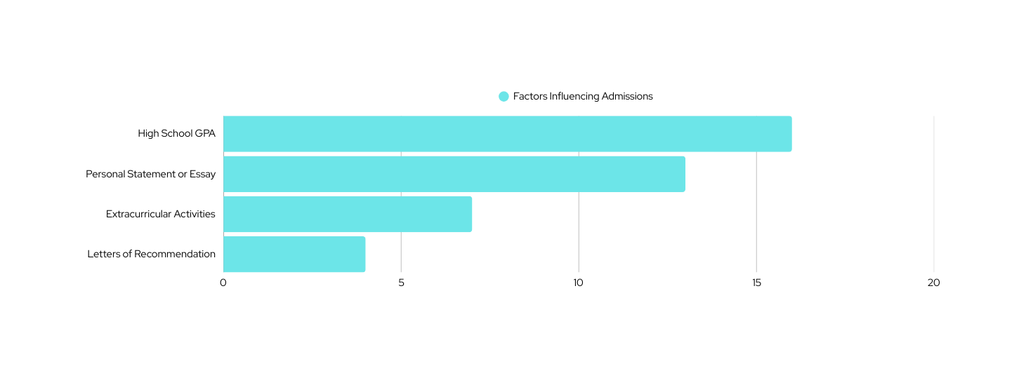
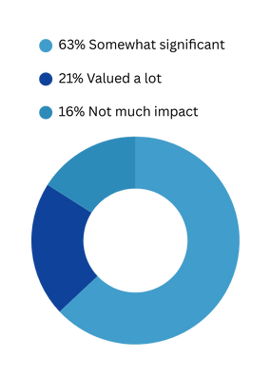
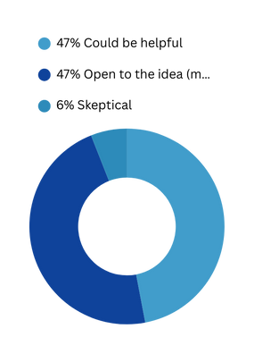
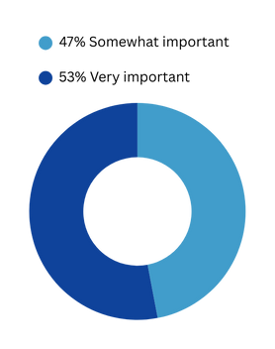
SURVEY RESULTS AND INSIGHTS
Educational Background
100%
Respondents reported being enrolled in or having completed undergraduate studies.
Perceived Importance of GPA
Extracurricular Activities
AI and Data Tools in Admissions
Application Experience
100%
Participants had applied to college or university, ensuring relevance to the survey theme.

Slide 9
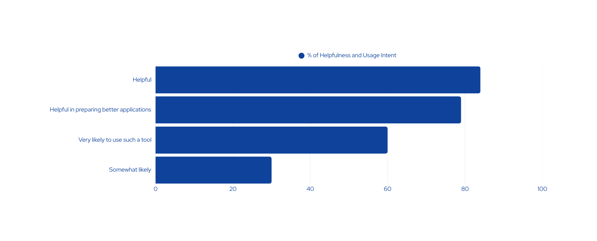
OPEN-ENDED INSIGHT
One respondent shared:
“It's important because it allows a student to understand where they stand and what they need to improve before applying.”

Slide 10

METHODOLOGY
Structured approach or framework used to collect, process, analyze, and interpret large and complex datasets to extract useful insights and support decision-making.
TOOLS & TECHNIQUES
DATA CLEANING
MODEL BUILDING
Python-based (random, math libraries — no external dependencies)
Logistic Regression & Decision Tree Classifiers
GPT used to process survey insights
Standardized GPA, SAT, and essay scores
Encoded extracurricular and qualitative data
Removed or replaced missing values
Dataset split into train/test sets
Models tested for accuracy, overfitting, interpretability

Slide 11

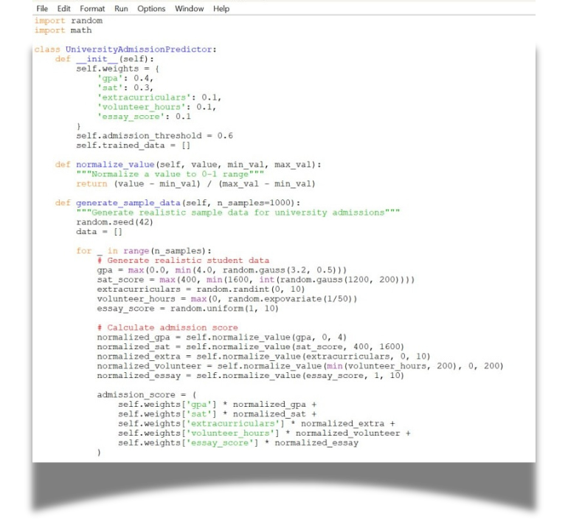
VISUALIZATIONS AND RESULTS:
CUSTOM PYTHON MODEL
Key Features (No External Dependencies):
Pure Python: Uses only random and math libraries
Smart Algorithm: Weighted scoring system with normalization
Realistic Predictions: Uses sigmoid function for probability calculation
Comprehensive Analysis: Detailed breakdowns and recommendations
Student Comparison: Side-by-side comparison feature
Interactive Mode: Real-time input and analysis

Slide 12
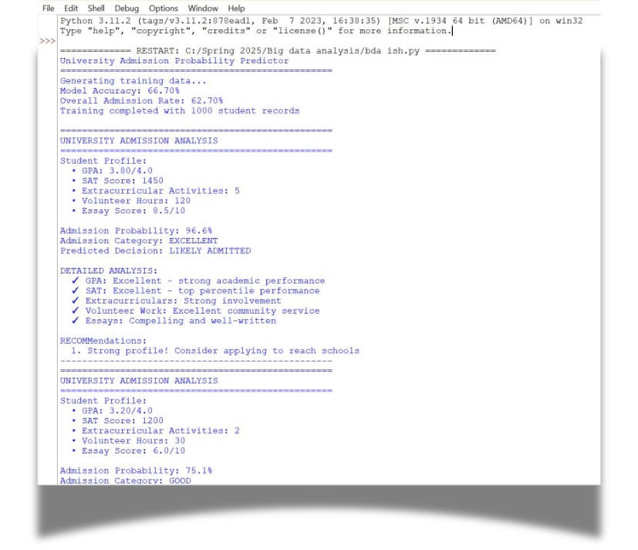
VISUALIZATIONS AND RESULTS:
CUSTOM PYTHON MODEL
How it works:
Weighted Scoring: GPA (40%), SAT (30%), others (10% each)
Normalization: Converts all inputs to 0-1 scale for fair comparison
Probability Calculation: Uses mathematical sigmoid function
Categories: EXCELLENT, GOOD, MODERATE, LOW, VERY LOW chances
Sample Output Categories:
Strong areas (green checkmarks in concept)
Average areas (neutral bullets)
Areas needing improvement (warning symbols)

Slide 13



GPT INTEGRATION
Generative Pre-Trained Transformers (GPT) were used as a supportive tool in this project to assist with text-based analysis and interpretation.
How GPT Helped
Insights GPT Revealed
Summarized long, open-ended survey answers
Detected emotional tone (e.g., anxiety, self-doubt)
Drafted narrative parts of the report
Highlighted the importance of fairness and guidance in admissions
Many students struggle with lack of clarity
Tools like ours offer psychological comfort and strategy
GPT supported a human-centered angle in this data-driven study

Slide 14




TEAM MEMBER CONTRIBUTIONS
The project was completed collaboratively by all team members, with each individual taking responsibility for a specific part of the workflow
01
Novikova Anna
Ochgerel Buyandelger
02
Designed and distributed the survey; collected and organized response data.
Handled model training and evaluation, including testing different algorithms.
ERALASH
03
Grishaeva Arina
Purev Nomin Erdene
04
Created data visualizations and contributed to writing the final report.
Performed data cleaning and preprocessing; ensured dataset consistency.

Slide 15

CHALLENGES & LEARNINGS
Survey Challenges
Limited student diversity in respondents
Hard to collect thoughtful long answers
Ethical Reflection
Technical Issues
Protected anonymity and informed consent
Aware of risks of using predictions in sensitive educational contexts
Emphasized ethical AI usage in education
Dataset was small and imbalanced
Feature diversity was limited
Preprocessing took significant effort

Slide 16



CONCLUSION & FUTURE WORK
Key Takeaways
Exploitation of Resources
Adaptation Costs
Successfully built a predictive model using student academic and extracurricular data.
Logistic Regression and Decision Tree classifiers showed solid performance.
GPT helped uncover emotional and strategic perspectives from survey responses.
Even simple features like GPA and SAT scores can create useful predictions when processed correctly.
Students value transparency and want tools to guide their efforts.
Combining quantitative data with qualitative feedback provides a more complete picture.
Incorporate additional data: school rank, socioeconomic background, interview results.
Expand the survey sample to include more diverse students globally.
Build a real-time web tool to help students assess and improve their admission chances.

Slide 17



THANK YOU
FOR ATTENTION
Team ERALASH

Slide 18


REFERENCES
Shah, D., & Bhatia, R. (2022). Predicting College Admissions with Machine Learning. International Journal of Educational Technology, 17(3), 112–125.
Wang, L., & Kim, H. (2023). Leveraging Student Data for University Admission Predictions. Journal of Data Science in Education, 11(1), 44–58.
Kaggle. (2024). Student Admission Dataset. Retrieved from: https://www.kaggle.com/datasets/amanace/student-admission-dataset
OpenAI. (2023). GPT-4 Technical Report. Retrieved from https://openai.com/research/gpt-4

